Slide 1
Reusable Sweat pH Monitor
Presented By:
Saketh Nannaka
2019501100

Slide 2
National University of Singapore (NUS) researchers have developed an upgrade to wearable health monitors that can read the pH of wearers' sweat. The pH Watch, which can be incorporated into current fitness trackers or smartwatches, can track the acidity or alkalinity level of the user's perspiration, along with heart rate and blood oxygen concentration, in real time. The researchers integrated a custom-made pH sensor and a pH sensing algorithm into pulse oximeter-equipped gadgets, which read sweat pH, heart rate, and blood oxygen saturation values with approximately 90% accuracy.

Slide 3
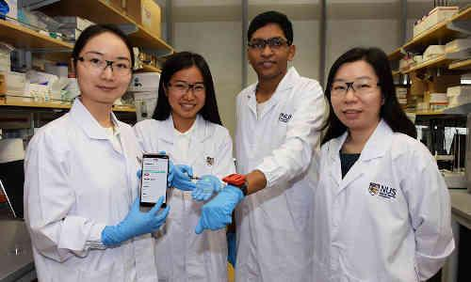
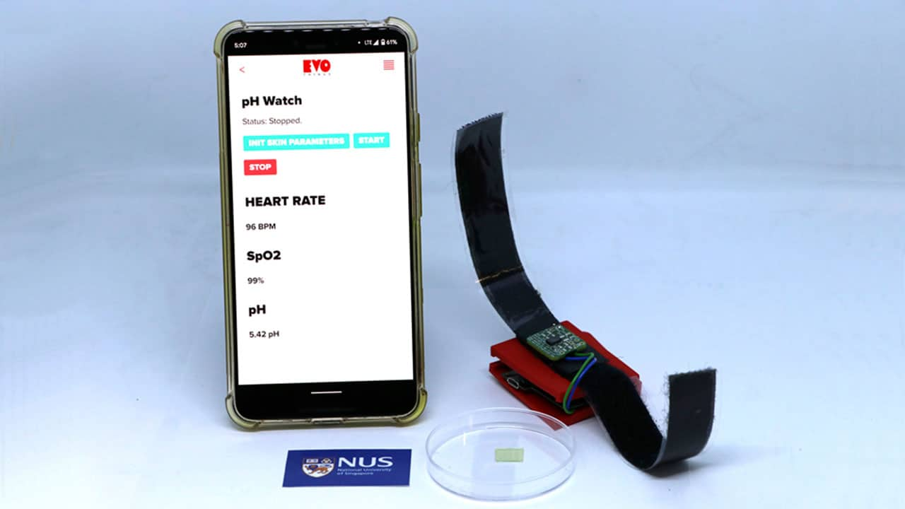

Slide 4
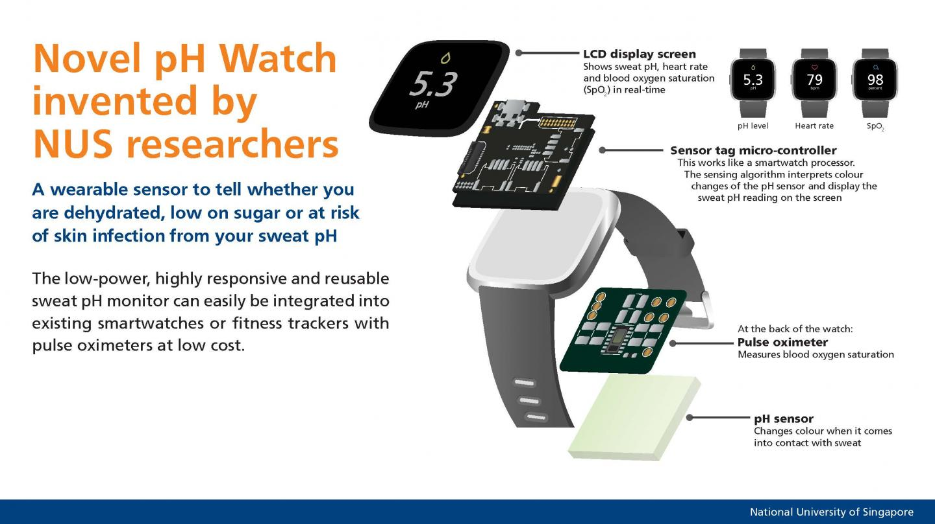

Slide 5
https://www.techexplorist.com/ph-watch-invented/29125/
Go through this link
You will get the content in detail

